Slide 1
Chapter 4
Representation of Linear Time Invariable Systems

Slide 2
Main Contents
Linear Time Invariant (LTI) Time-
continuous System
---time domain representation
---Frequency domain representation
LTI Time-discrete System
---Time Domain Representation
---Frequency Domain Representation

Slide 3
§4.1 Linear Time-Invariant time-continuous system (time domain)
Signal f(t) pass though system, output y(t):
f(t)
h(t)
y(t)
If satisfy
af(t) → ay(t) and f₁(t) + f₂(t) → y₁(t)+ y₂(t)
That is af₁(t) +b f₂(t) → ay₁(t)+ by₂(t)
The system is called linear.

Slide 4
§4.1 Linear Time-Invariant time-continuous system
If satisfy
f(t – t₀) → y(t – t₀)
The system is called time-invariant.
The reason to study linear time-invariant system is that based on δ(t) shifted and weighted sum representation of f(t), we can only discuss the system response for unit impulse, then make the sum of responses for all shifted and weighted impulses to get the whole response. It can be done only with linear time-invariant systems.

Slide 5
§4.1 Linear Time-Invariant time-continuous system
Causal and noncausal system
A system is causal if the output at any time depends only on values of the input at the present time and in the past. Otherwise ,noncausal.
Example
y(t)=f(t)+f(t-4) this is causal
y(t)=f(t+4) is noncausal

Slide 6


§4.2 System unit impulse response
The system response for unit impulse δ(t) is called system unit impulse response, and denoted as h(t)
h(t) is important figure of linear time-invariant system. It can be done to get response for any input signal based on h(t), because any signal can be represented as shifted and weighted sum of δ(t).

Slide 7
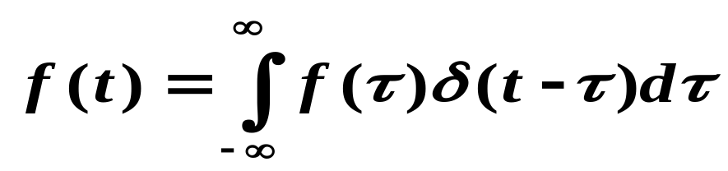
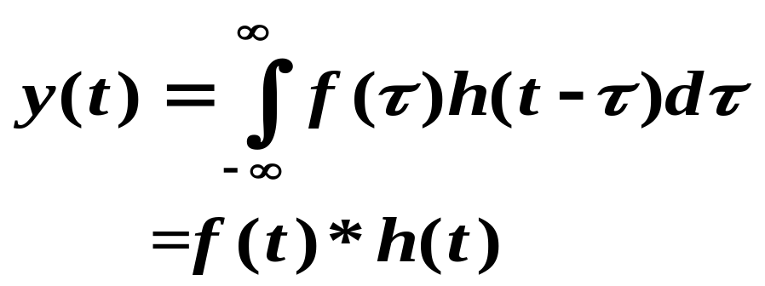
§4.3 Signal pass through linear time-invariant system
δ(t) →h(t)
aδ(t – t₀) → ah(t – t₀)
Denote y(t) = f(t) * h(t), which is called convolution of f(t) and h(t)

Slide 8
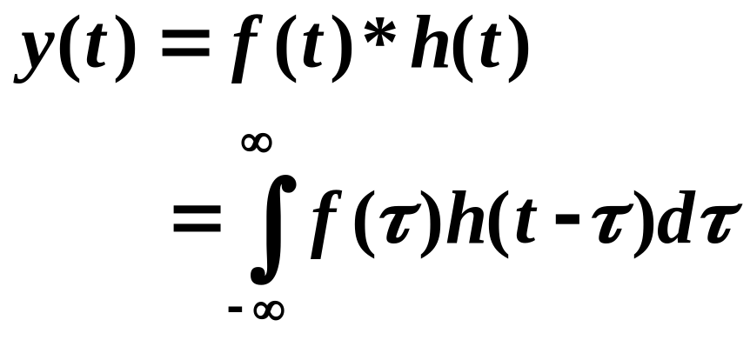
§4.3 Signal pass through linear time-invariant system
Conclusion:
When a signal passes through a linear time-invariant system, the system output is the convolution of input and the system impulse response.

Slide 9
§4.4 Fourier analysis of linear time- continuous system (frequency domain)
Such transform-domain representations provide additional insight into the behavior of systems
It is easier to design and implement these systems in the transform-domain for certain applications
We consider now the use of the FT in developing the transform-domain representations of an LTI system

Slide 10
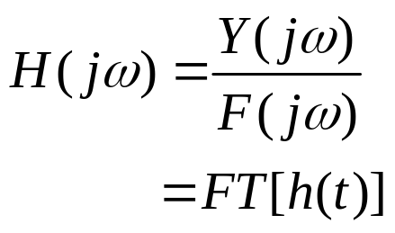
§4.4 Fourier analysis of linear time- continuous system (frequency domain)
f(t)
h(t)
H(jω)
y(t)
F(jω)
Y(jω)
y(t) = f(t) * h(t)
Y(jω) = F(jω) H(jω)

Slide 11
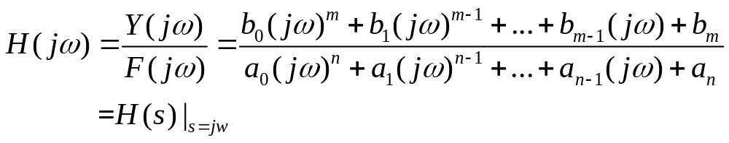
§4.4 Fourier analysis of linear time- continuous system (frequency domain)
H(jω) is called the frequency response of the LTI continuous-time system.
it is also called system function or transform function, and also represented as
H(jω) provides a frequency-domain description of the system
H(jω) is precisely the FT of the impulse response {h[t]} of the system

Slide 12
§4.4 Fourier analysis of linear time- continuous system (frequency domain)
H(jw), in general, is a complex function of ω
It can be expressed in terms of its real and imaginary parts
H(jw)= H_{re}(jw) +j H_{im}(jw)
or, in terms of its magnitude and phase,
H(jw)=|H(jw)| e^{θ(ω)}
where
θ(ω)=argH(jw)
magnitude response
(even)
Phase response (odd)

Slide 13
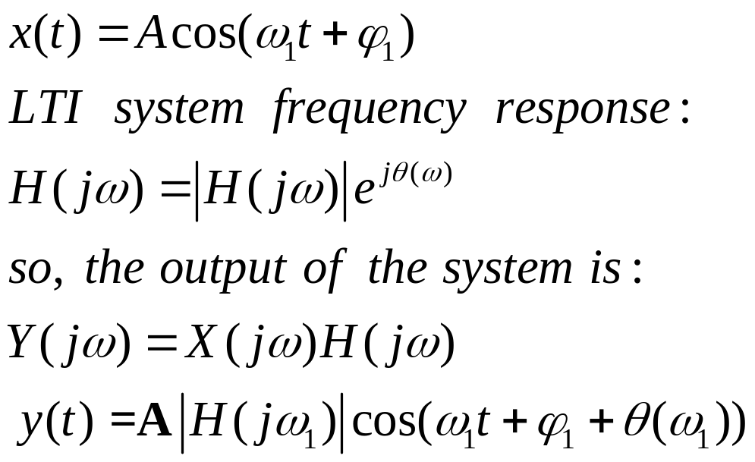
§4.4 Fourier analysis of linear time- continuous system (frequency domain)
Spectrum analyses is an active research area today.
If system is too complicated to be represented by
analytical expression, it could be done that input sin
signals with different frequencies and measure the
system output, then give the system transfer function.
example:

Slide 14
§4.5 LTI Discrete-Time Systems
(time domain)
A single-input, single-output discrete-time system operates on a sequence, called the input sequence, according some prescribed rules and develops another sequence, called the output sequence, with more desirable properties
h(n)
x[n]
Discrete-time
y[n]
system
Input sequence
Output sequence

Slide 15
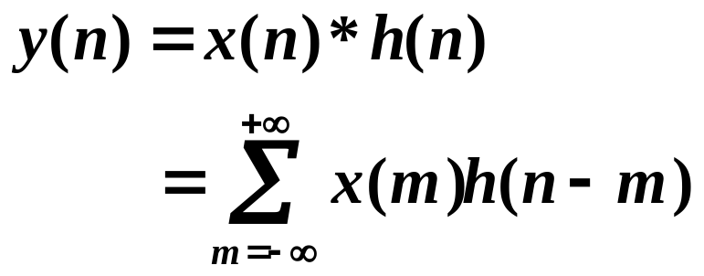


§4.5 LTI Discrete-Time Systems
(time domain)
Output:
h(n): unit impulse response of the system, as follow:
In this course ,we mainly study the linear time-invariant
discrete-time systems.(linearity,time invariance and causality)

Slide 16
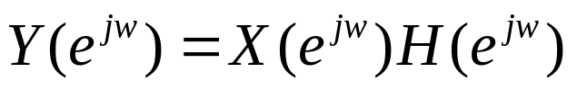
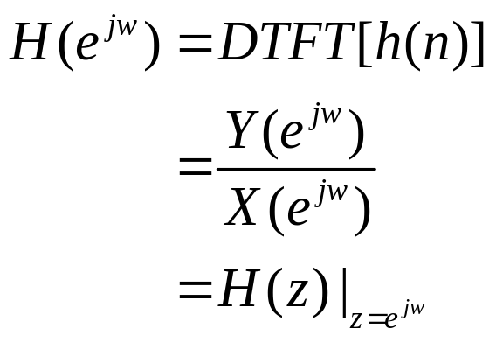
§4.6 LTI Discrete-Time Systems in the
Frequency Domain
We consider now the use of the DTFT in developing the transform-domain representations of an LTI system

Slide 17
§4.6 LTI Discrete-Time Systems in the
Frequency Domain
H(e^{jω}) is called the frequency response of the LTI discrete-time system
H(e^{jω}) provides a frequency-domain description of the system
H(e^{jω}) is precisely the DTFT of the impulse response {h[n]} of the system
H(e^{jω})=DTFT{h(n)}

Slide 18
§4.6 LTI Discrete-Time Systems in the
Frequency Domain
H(e^{jω}), in general, is a complex function of ω with a period 2π
It can be expressed in terms of its real and imaginary parts
H(e^{jω})= H_{re}(e^{jω}) +j H_{im}(e^{jω})
or, in terms of its magnitude and phase,
H(e^{jω})=|H(e^{jω})| e^{jθ(ω)}
where
θ(ω)=argH(e^{jω})
Magnitude (even)
Phase (odd)

Slide 19
§4.6 LTI Discrete-Time Systems in the
Frequency Domain
The function | H(e^{jω}) | is called the magnitude response and the function θ(ω) is called the phase response of the LTI discrete-time system
Design specifications for the LTI discrete-time system, in many applications, are given in terms of the magnitude response or the phase response or both

Slide 20
§4.6 LTI Discrete-Time Systems in the
Frequency Domain
Note: Magnitude and phase functions are real functions of ω, whereas the frequency response is a complex function of ω
If the impulse response h[n] is real then the magnitude function is an even function of ω:
|H(e^{jω})| = |H(e ⁻ ^{jω})|
and the phase function is an odd function of ω:
θ(ω) = - θ(-ω)

Slide 21
§4.6 LTI Discrete-Time Systems in the
Frequency Domain
Most discrete-time signals encountered in practice can be represented as a linear combination of a very large, maybe infinite, number of sinusoidal discrete-time signals of different angular frequencies
Thus, knowing the response of the LTI system to a single sinusoidal signal, we can determine its response to more complicated signals by making use of the superposition property

Slide 22
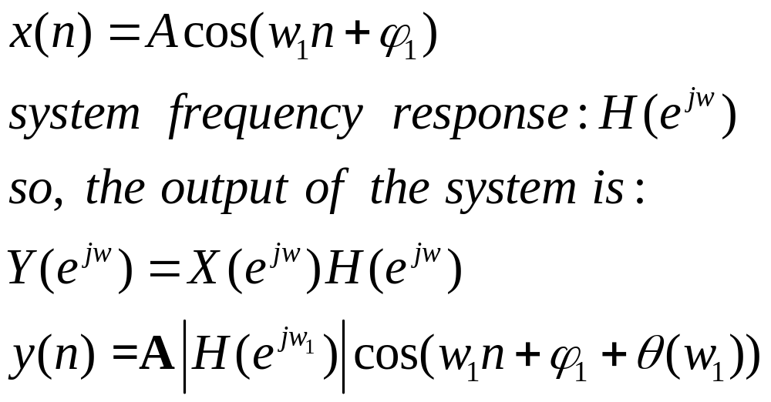
§4.6 LTI Discrete-Time Systems in the
Frequency Domain
Example:

Slide 23
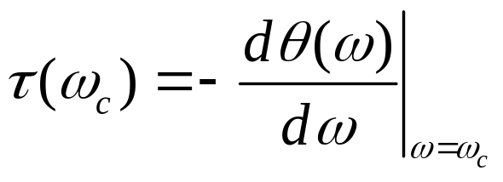
§4.7 Group Delays
The parameter
is called the group delay or envelope delay caused by the system at ω= ω_{c}

Slide 24

§4.7 Group Delays
The group delay is a measure of the linearity of the phase function as a function of the frequency
It is the time delay between the input and the output signals at each frequencies points of the signals.
If is a constant, then the system output has no waveform distortion and is called linear phase system.

Slide 25
§4.7 Group Delays
If the phase function and the angular frequency ω are in radians per second, then the group delay is in seconds

Slide 26
§4.8 The Concept of Filtering
One application of an LTI system is to pass certain frequency components in an input signal without any distortion (if possible) and to block other frequency components
Such systems are called filters and one of the main subjects of discussion in this course
They are also called frequency-selective filters

Slide 27




§4.8.1 Ideal Analog Filter
Low pass
High pass
Band pass
Band stop pass

Slide 28
§4.8.1 Ideal Analog Filter
As, h_{LP}[t]=FT⁻¹[H(jw)]is not causal and is of doubly infinite length
The remaining three ideal filters are also characterized by doubly infinite, noncausal impulse responses and are not absolutely summable
Thus, the ideal filters with the ideal “brick wall” frequency responses cannot be realized with finite dimensional LTI filter

Slide 29
§4.10.1 Ideal Filters
To develop stable and realizable transfer functions, the ideal frequency response specifications are relaxed by including a transition band between the passband and the stopband.
This permits the magnitude response to decay slowly from its maximum value in the passband to the zero value in the stopband.
Moreover, the magnitude response is allowed to vary by a small amount both in the passband and the stopband

Slide 30
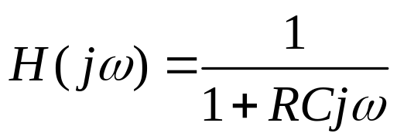










Two simple analog filter examples:
RC low pass filter:
R
C

Slide 31
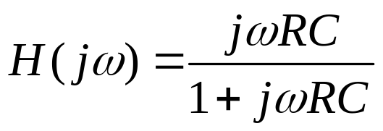


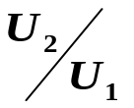




RC high pass filter:
C
R

Slide 32
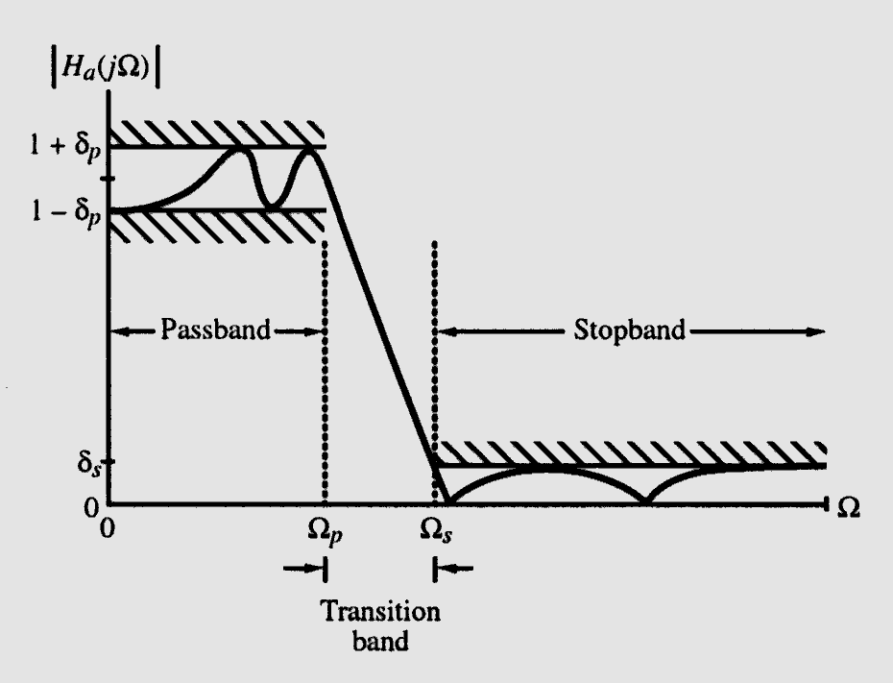
§4.8.2 Analog Lowpass Filter
Typical magnitude response |H_{a}(jΩ)| of an analog lowpass filter may be given as indicated below
Ω: analog angular frequency

Slide 33
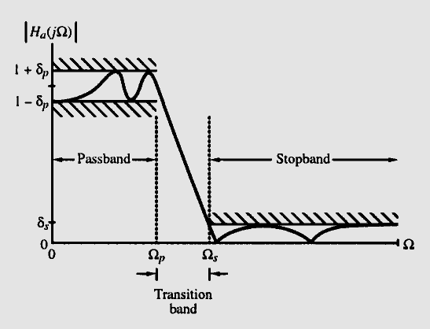
§4.8.2 Analog Lowpass Filter
In the passband, defined by 0≤ Ω ≤ Ω_{p} , we require
1-δ_{p} ≤ |H_{a}(jΩ)| ≤ 1+ δ_{p} , |Ω| ≤ Ω_{p}
i.e., |H_{a}(jΩ)| approximates unity within an error of ±δ_{p}
In the stopband, defined by Ω_{s} ≤ Ω ≤ ∞, we require
|H_{a}(jΩ)| ≤ δ_{s} Ω_{s} ≤ Ω ≤ ∞
i.e |H_{a}(jΩ)| approximates zero
within an error of δ_{s}

Slide 34
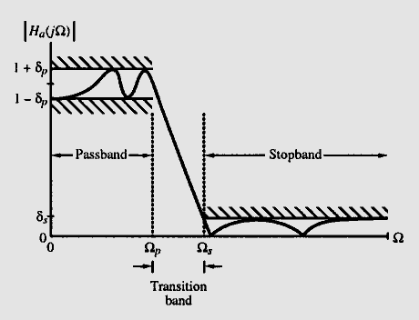
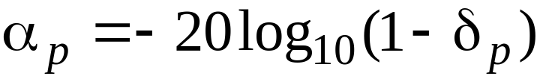

§4.8 Analog Lowpass Filter
Ω_{p} - passband edge frequency
Ω_{s} - stopband edge frequency
δ_{p} - peak ripple value in the passband
δ_{s} - peak ripple value in the stopband
Peak passband ripple
dB
Minimum stopband attenuation
dB

Slide 35
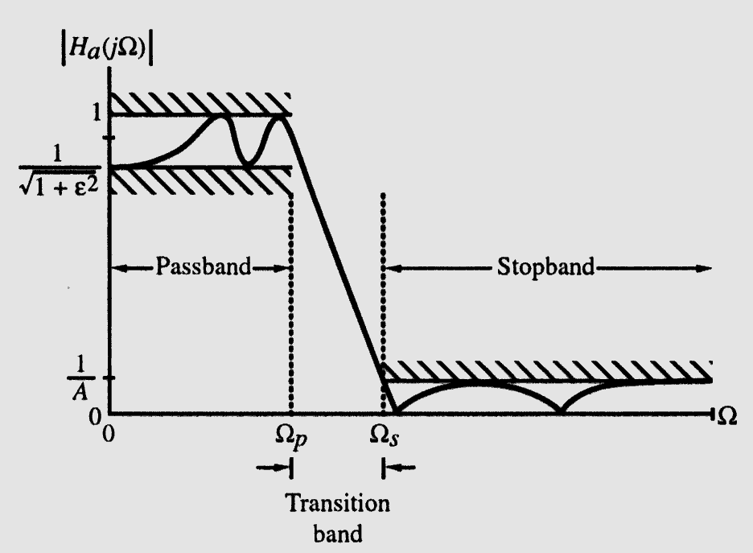
§4.8 Analog Lowpass Filter
Magnitude specifications may alternately be given in a normalized form as indicated below

Slide 36
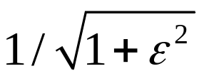
§4.8 Analog Lowpass Filter
Here, the maximum value of the magnitude in the passband assumed to be unity
- Maximum passband deviation, given by the minimum value of the magnitude in the passband
1/A - Maximum stopband magnitude

Slide 37
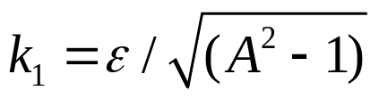
§4.9 Analog Lowpass Filter
Design
Two additional parameters are defined in order to design the lowpass filter
(1) Transition ratio k = Ω_{p}/ Ω_{s}
For a lowpass filter k<1
(2) Discrimination parameter
Usually k₁<<1

Slide 38
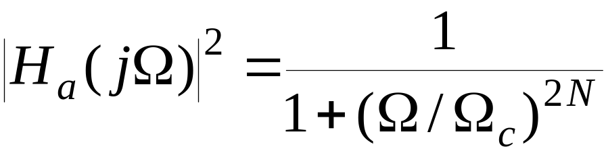
§4.9.1 Butterworth Approximation
The magnitude-square response of an N-th order analog lowpass Butterworth filter is given by
First 2N - 1 derivatives of |H_{a}(jΩ)|² at Ω = 0 are equal to zero
The Butterworth lowpass filter thus is said to have a maximally-flat magnitude at Ω = 0

Slide 39

§4.9.1 Butterworth Approximation
Gain in dB is
G(Ω)=10log₁₀|H_{a}(jΩ)|²
As G(0)=1and |H_{a}(jΩ)|=
G(Ω_{c})=10log₁₀(0.5)=-3.0103≅-3 dB
Ω_{c} is called 3-dB cutoff frequency

Slide 40
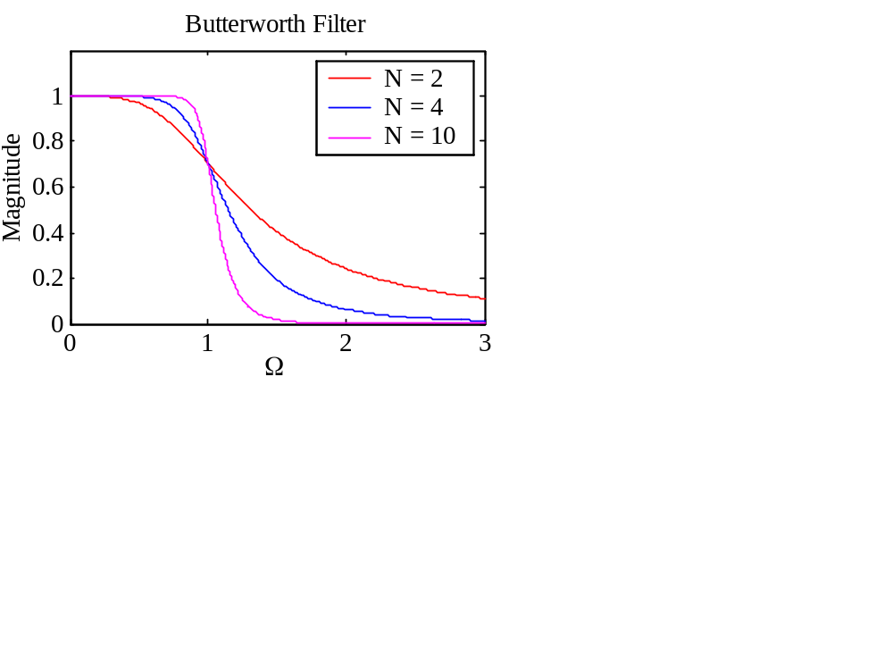
§4.9.1 Butterworth Approximation
Typical magnitude responses with Ω_{c} =1

Slide 41

§4.9.1 Butterworth Approximation
Two parameters completely characterizing a Butterworth lowpass filter are Ω_{c} and N
These are determined from the specified bandedges Ω_{p} and Ω_{s} , and minimum passband magnitude , and maximum stopband ripple 1/A

Slide 42
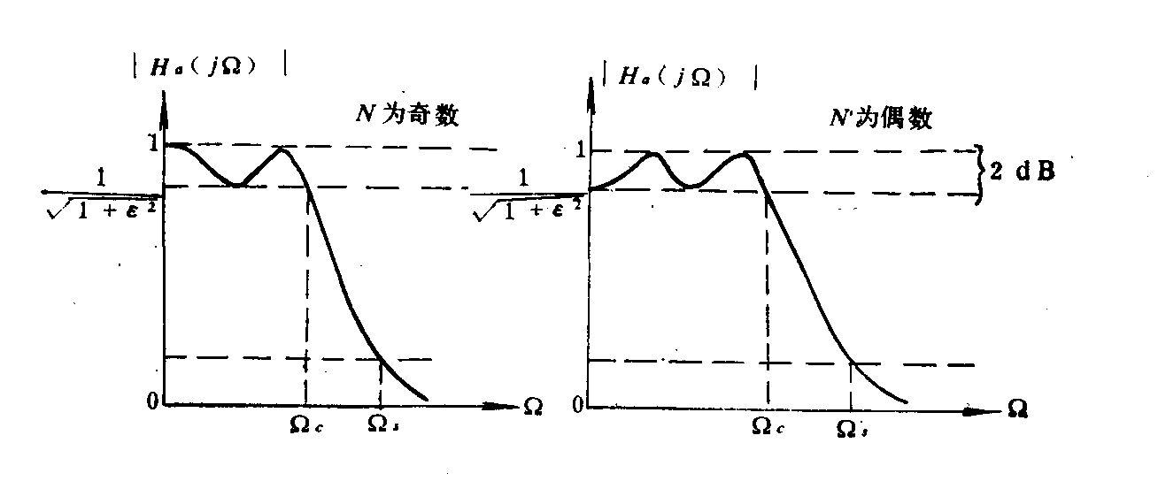
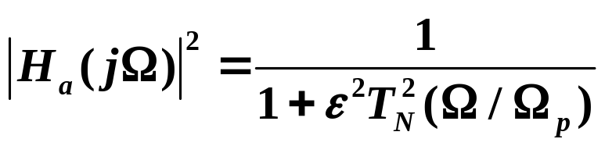
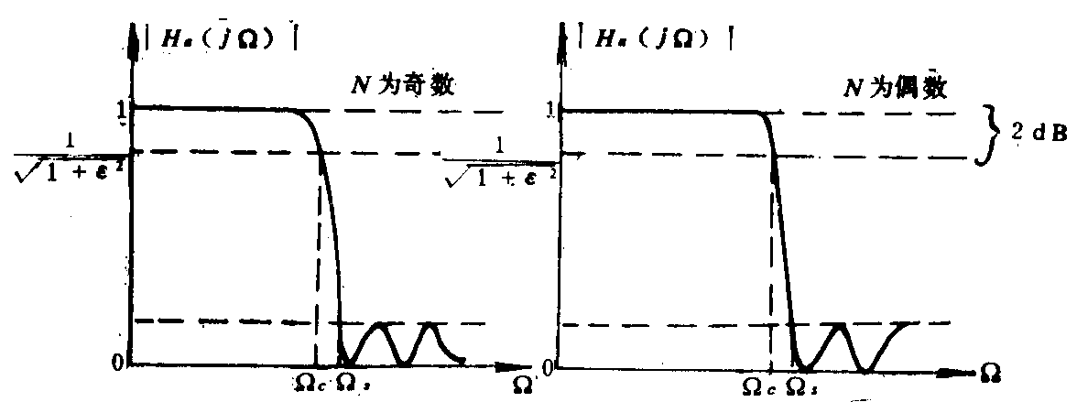
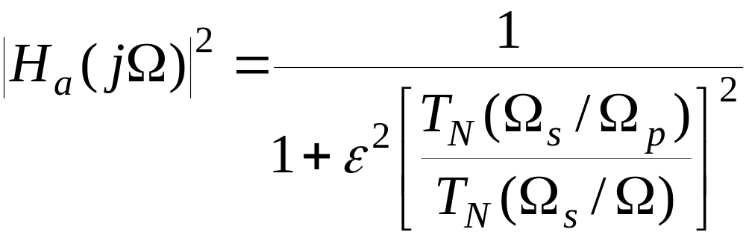
§4.9.2 Chebyshev Filter
Type(I)
Type(II)

Slide 43
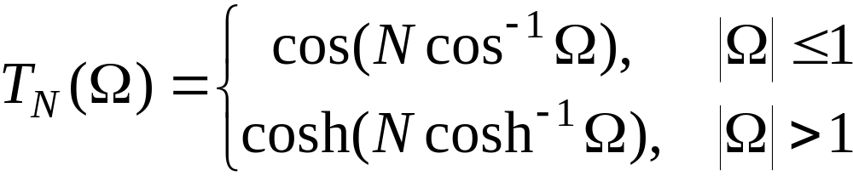
§4.9.2 Chebyshev Filter
The magnitude-square response of an N-th order analog lowpass Type 1 Chebyshev filter is given by
where T_{N}(Ω) is the Chebyshev polynomial of order N:

Slide 44
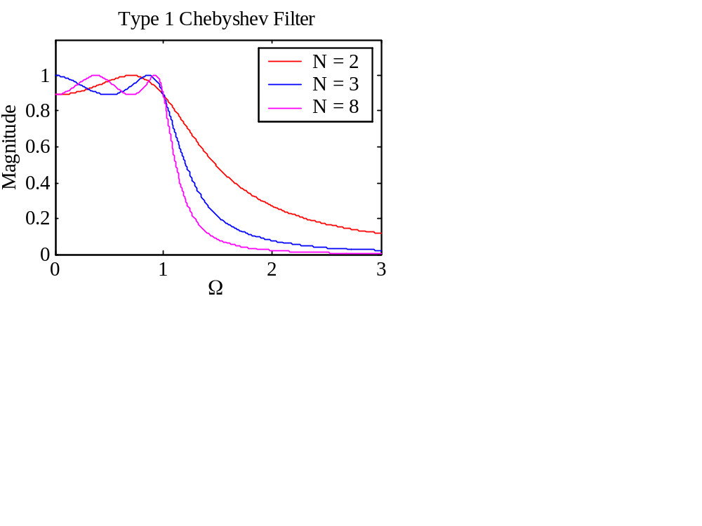
§4.9.2 Chebyshev Filter
Typical magnitude response plots of the analog lowpass Type 1 Chebyshev filter are shown below

Slide 45
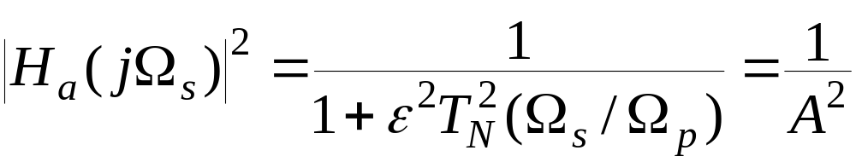
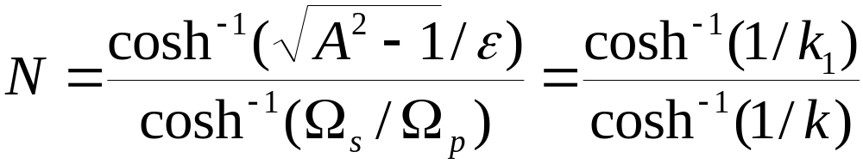
§4.9.2 Chebyshev Filter
If at Ω = Ω_{s} the magnitude is equal to 1/A, then
Solving the above we get
Order N is chosen as the nearest integer greater than or equal to the above value

Slide 46
§4.9.2 Chebyshev Filter
The magnitude-square response of an N-th order analog lowpass Type 2 Chebyshev (also called inverse Chebyshev) filter is given by
where T_{N}(Ω) is the Chebyshev polynomial of order N

Slide 47
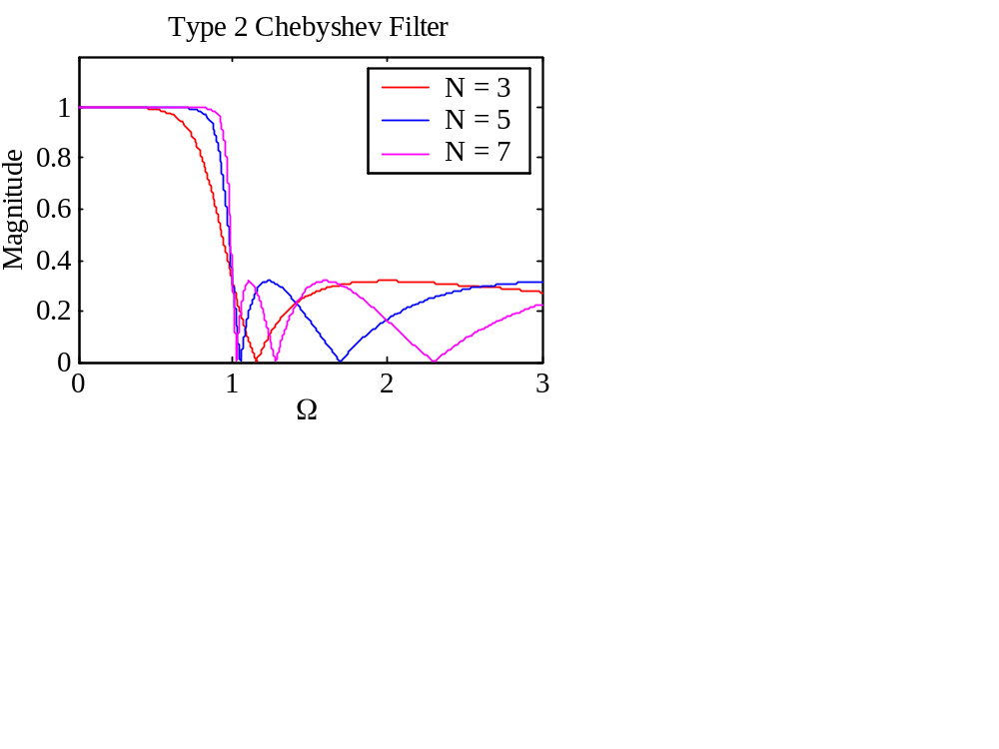
§4.9.2 Chebyshev Filter
Typical magnitude response plots of the analog lowpass Type 2 Chebyshev filter are shown below

Slide 48
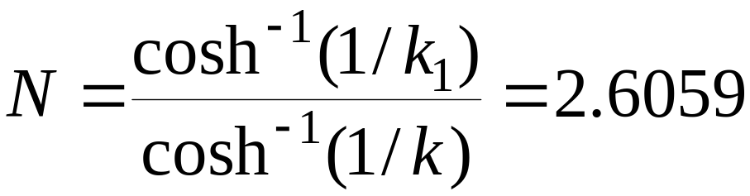
§4.9.2 Chebyshev Filter
The order N of the Type 2 Chebyshev filter is determined from given ε, Ω_{s}, and A using
Example - Determine the lowest order of a Chebyshev lowpass filter with a -1dB cutoff frequency at 1 kHz (fc) and a minimum attenuation of 40 dB at 5 kHz (fs)-

Slide 49
§4.10 Digital Filter
the same function as analog filter, which permits some frequency passing through the system and block other frequency components.
the difference is that digital filter is a discrete time system and its input and output are all sequences.

Slide 50
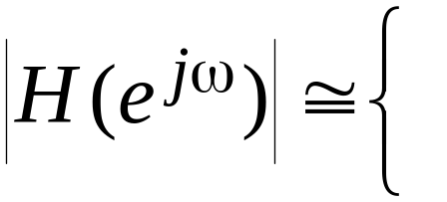
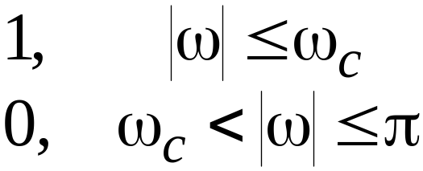
§4.10 Digital Filter
To understand the mechanism behind the design of frequency-selective filters, consider a real-coefficient LTI discrete-time system characterized by a magnitude function

Slide 51
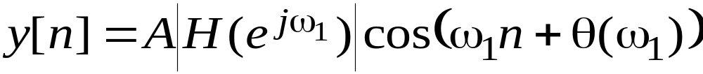
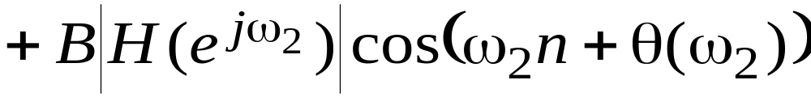
§4.10 Digital Filter
We apply an input
x[n]=Acosω₁n+Bcosω₂n, 0< ω₁< ω_{c}< ω₂<π
to this system
Because of linearity, the output of this system is of the form

Slide 52
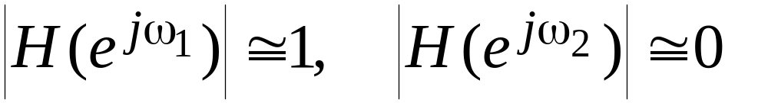
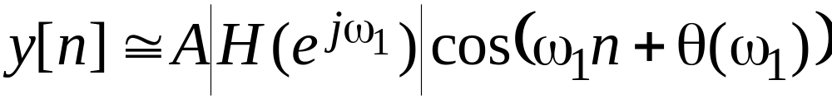
§4.10 Digital Filter
As
the output reduces to
Thus, the system acts like a lowpass filter

Slide 53
§4.10.1 Ideal Filters
A digital filter designed to pass signal components of certain frequencies without distortion should have a frequency response equal to one at these frequencies, and should have a frequency response equal to zero at all other frequencies

Slide 54
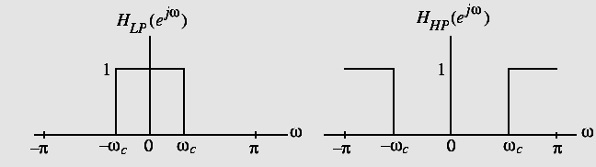
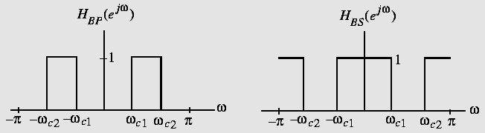
§4.10.1 Ideal Filters
An ideal filter has a magnitude response equal to one in the passband and zero in the stop-band, and has a zero phase everywhere
There are four ideal digital filters with real impulse response coefficients

Slide 55
§4.10.1 Ideal Filters
The range of frequencies where the frequency response takes the value of one is called the passband
The range of frequencies where the frequency response takes the value of zero is called the stopband
The frequencies ω_{c}, ω_{c1}, and ω_{c2} are called the cutoff frequencies

Slide 56
§4.10.1 Ideal Filters
By calculate the inverse DTFT of the frequency response H_{LP}(e^{jω}) , impulse responds of the ideal lowpass filter is:
h_{LP}[n]=sinω_{c}n/nπ, - ∞ <n< ∞
We have also shown that the above impulse response is not absolutely summable, and hence, the corresponding transfer function is not BIBO stable

Slide 57
§4.10.1 Ideal Filters
As the above four ideal filters are noncausal impulse responses and are not absolutely summable.
Thus, the ideal filters with the ideal “brick wall” frequency responses cannot be realized with finite dimensional LTI filter
The realized digital filters should be as follows:

Slide 58
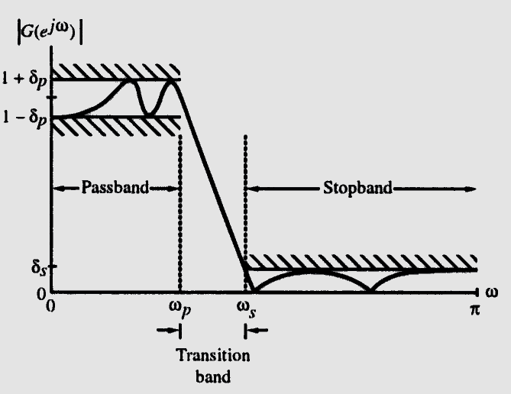
§4.10.1 Ideal Filters
Typical magnitude response of a lowpass filter are shown as:

Slide 59

§4.10.2 Types of digital filter
The time-domain classification of an LTI digital filter is based on its impulse response:
--IIR filter (Infinite impulse response) :
h(n) is a infinite sequence
-- FIR filter (Finite impulse response) :
h(n) is a finite sequence
-- Casual filter: if h(n)=0, n<0
-- Non-casual filter: if
-- linear phase digital filter:
H(e^{jω})=|H(e^{iw})| e^{jωD}
which has a linear phase from ω = 0 to ω = 2π

Slide 60
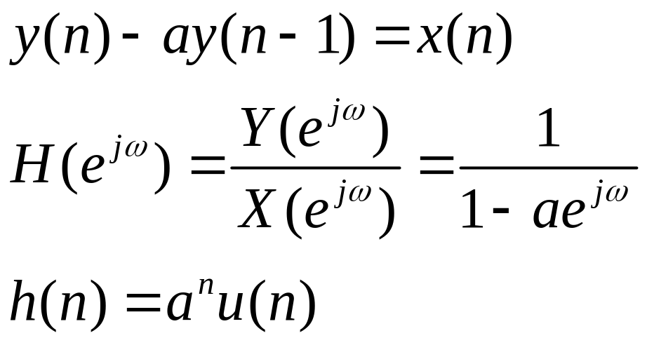
Examples of different types of digital filters
IIR filter
This is first-order recursive discrete time filter
---lowpass filter

Slide 61
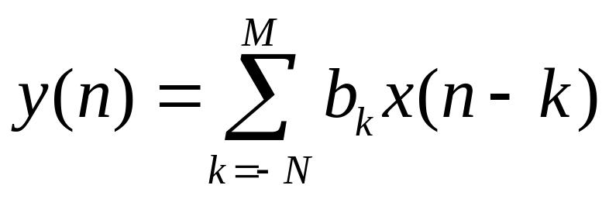
FIR filter
---------moving-average filter
the output y(n) is a weighted average of (N+M+1) values
of x(n) from x(n-M) to x(n+N) with weights given by the
coeficients b_{k.}
A frequently used example of such a filter is a
moving-average filter.

Slide 62
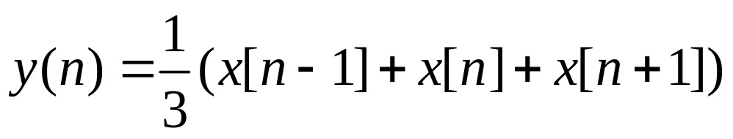
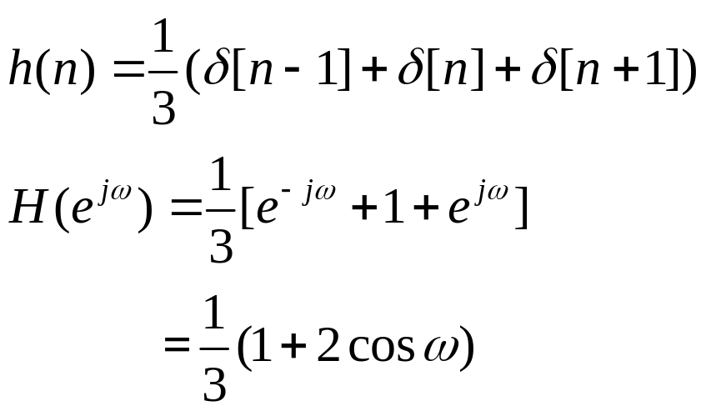
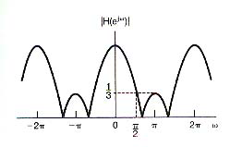
Such as: three-averages filter is :
This filter has the characteristics of a lowpass filter.

Slide 63
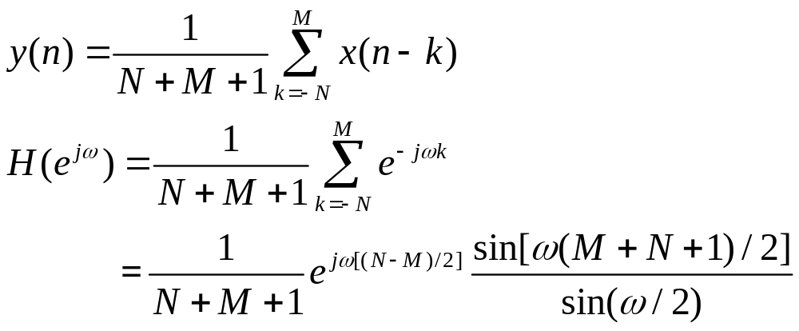
Modified moving average filter:
The above filter’s performance can not be adjusted because there is no parameters could be changed. The following filter will improve this :

Slide 64
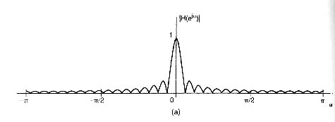
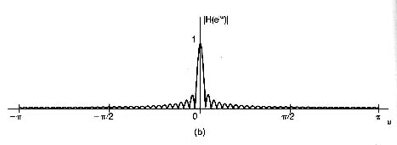
M=N=16
M=N=32

Slide 65

Note:
--The above moving average filters are FIR , so,
they are always stable.
--If N>0, filters are noncasual.
--In some applications ,causality is not a
necessary constraint, it is free to use filters
with N>0 (such as median filtering in image procssing)
--but in real-time processing, causality is
essential and we must take

Slide 66


FIR filter -----highpass filter

Slide 67
§4.10.2 Types of digital filter
FIR filter ---- linear phase digital filter
filter has a linear phase, if its impulse response h[n] is either symmetric, i.e.,
h[n]=h[N-1-n], 0≤n≤N-1
or is antisymmetric, i.e.,
h[n]=-h[N-1-n], 0≤n≤N-1
N : even or odd

Slide 68


§4.10.3 Linear-Phase FIR DF
Type 1: N = 9
Type 2: N = 8
Type 3: N = 9
Type 4: N = 8

Slide 69
§4.10.3 Linear-Phase FIR DF
It is nearly impossible to design a linear-phase IIR transfer function
It is always possible to design an FIR transfer function with an exact linear-phase response

Slide 70
§4.10.3 Linear-Phase FIR DF
Since the length of the impulse response can be either even or odd, we can define four types of linear-phase FIR transfer functions
We examine next the each of the 4 cases

Slide 71

Symmetric case

Slide 72

Ansymmetric case

Slide 73





§4.10.3 Linear-Phase FIR DF
Type 1: FIR filters, N=odd, symmetric
combined

Slide 74







§4.10.3 Linear-Phase FIR DF
let：

Slide 75




§4.10.3 Linear-Phase FIR DF
then：
Magnitude ：
phase：

Slide 76




§4.10.3 Linear-Phase FIR DF
Type 2: N=even ,symmetric

Slide 77


§4.10.3 Linear-Phase FIR DF
type3: N=odd, ansymmetric

Slide 78




§4.10.3 Linear-Phase FIR DF
Type4: N=even, ansymmetric

Slide 79





§4.10.3 Linear-Phase FIR DF
Linear-Phase FIR filter:
even symmetric
odd symmetric
Group delay：
is a constant！

Slide 80
§4.10.3 Linear-Phase FIR DF
Example - Consider
which is seen to be a slightly modified version of a length-7 moving-average (MA) FIR filter
The above transfer function has a symmetric impulse response and therefore a linear phase response

Slide 81
§4.10.3 Linear-Phase FIR DF
A plot of the magnitude response of along with that of the 7-point moving-average filter is shown below
1
modified filter
0.8
moving-average
0.6
Magnitude
0.4
0.2
0
0
0.2
0.4
0.6
0.8
1
ω
/
π

Slide 82
§4.10.3 Linear-Phase FIR DF
Note the improved magnitude response obtained by simply changing the first and the last impulse response coefficients of a moving-average (MA) filter
It can be shown that we can express
which is seen to be a cascade of a 2-point MA filter with a 6-point MA filter
Thus, H₀(z) has a double zero at z=-1, i.e.,
(ω = π)

Slide 83

§4.10.3 Linear-Phase FIR DF
Example:
Type 1:Symmetric Impulse Response with Odd Length
In this case, the degree N is even
Assume N = 8 for simplicity
The transfer function H(z) is given by

Slide 84
§4.10.3 Linear-Phase FIR DF
Because of symmetry, we have h[0]=h[8], h[1] = h[7], h[2] = h[6], and h[3] = h[5]
Thus, we can write

Slide 85
§4.10.3 Linear-Phase FIR DF
The corresponding frequency response is then given by
The quantity inside the braces is a real function of ω, and can assume positive or negative values in the range 0≤|ω|≤π

Slide 86


§4.10.3 Linear-Phase FIR DF
The phase function here is given by
where β is either 0 or π, and hence, it is a linear function of ω in the generalized sense
The group delay is given by
indicating a constant group delay of 4 samples

